Slide 1
Phylum Mollusca

Slide 2
Introduction
Includes animals such as chitons, tusk shells, snails, slugs, nudibranchs, clams, mussels, oysters, squid, and octopus.
Most are marine, but many are freshwater and some live on land.
Despite the diversity of form and function among the molluscs, all members of this group have the same body plan.
This is often indicated by presenting a hypothetical ancestral mollusc (HAM)
HAM is a hypothetical primitive ancestor that has characteristics that appear among most members of the mollusca.

Slide 3
A Closer Look at HAM
The foot – a broad, flat muscular organ that is adapted for locomotion and attachment.
The visceral mass – contains the internal organs
The mantle – a fold of tissue that drapes over the visceral mass; space between the mantle and the visceral mass is called the mantle cavity.

Slide 4
The Shell
The mantle is responsible for secreting the shell.
The shell is comprised of three layers:
- the outside of the shell is covered by an organic layer
(periostracum)
- the middle prismatic layer is characterized by densely
packed prisms of calcium carbonate laid down in a
protein matrix.
- The inner nacreous layer
is composed of calcium
carbonate sheets laid
down over a thin layer
of protein.

Slide 5
Shell
Mantle

Slide 6
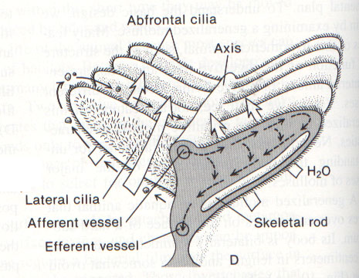
Gills
The gills of HAM are often indicated as one or more pairs of bipectinate gills – flattened filaments attached to a longitudinal axis on either side.

Slide 7
The Radula
The mouth cavity of HAM possesses a specialized rasping organ called the radula; sits on a cartilaginous structure – odontophore
Particles of food brought into the mouth are bound in mucous secreted by the salivary glands.

Slide 9
Other Features of HAM
Nervous system consists of a nerve ring and 2 longitudinal nerve cords
Coelom is reduced
Open Circulatory System
The excretory organs
of the molluscs are
metanephridia; inner
ends open into the
coelom via a ciliated
funnel called the
nephrostome; wastes
leave the body via the
nephridiophore.

Slide 10
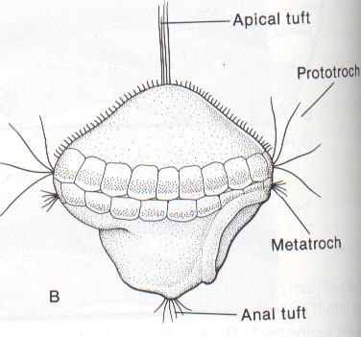
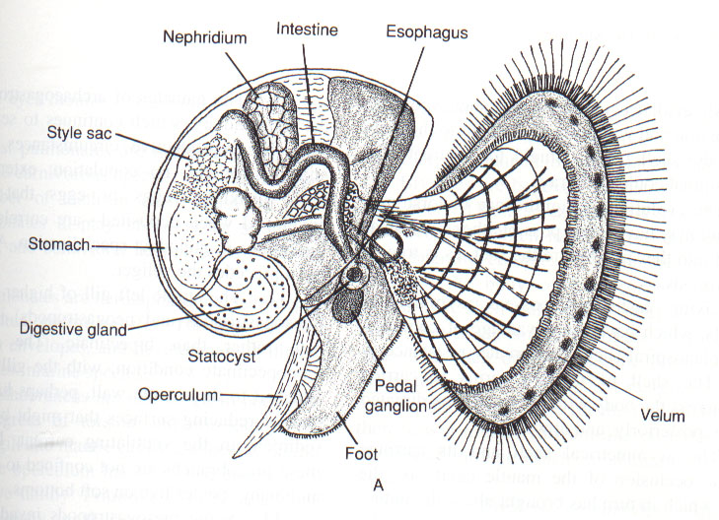
Molluscan Larval Stages
Most molluscs produce a free-swimming ciliated larvae called the trocophore larvae
In some molluscs the trocophore develops into the adult, but in other molluscs (e.g. gastropods) there is a second larval stage called the veliger

Slide 12
Molluscan Diversity

Slide 13
Mollusc Phylogeny

Slide 14
Class Polyplacophora (Chitons)
Common on the rocky surfaces of the intertidal zone
Head is poorly developed; ventral surface occupied by a broad, flattened foot.
Has a dorsal shell composed of 8 overlapping plates, arranged linearly along the anterior-posterior axis.
Lateral margins of the plates are overgrown to varying degrees by the girdle.
Mantle cavity is limited to two lateral troughs between the foot and the mantle edge = pallial grooves.
Within the grooves
lie many bipectinate
gills

Slide 15
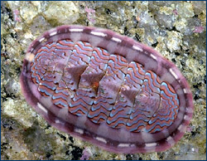
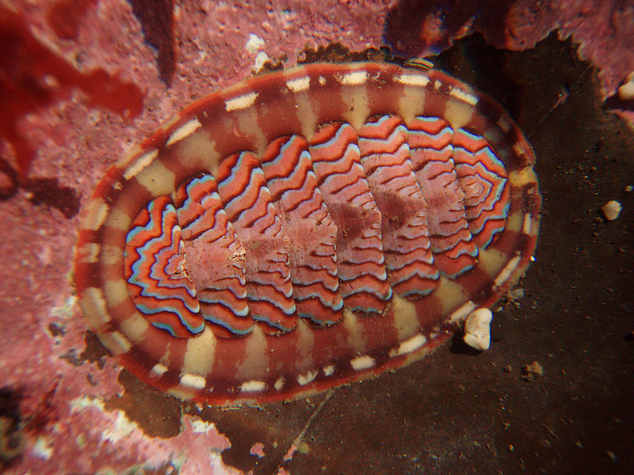
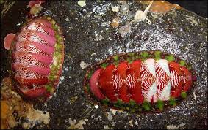

Slide 16
Class Gastropoda
Three evolutionary innovations occurred among the gastropods:
-changes in the shell, increased development of the head, and
the embryonic process of torsion
Changes in the shell - bilaterally symmetrical → asymmetrical
Increased development of the head:
- the head bears 2 pairs of tentacles, with the eyespots at the
base of one pair
eyespots
tentacles

Slide 17
3. The Embryonic Process Known as Torsion
- During embryonic development, 1 side of the visceral mass
grows at a much faster rate than the other.
- Causes the visceral mass to rotate 180 degrees relative to the
head-foot
- Advantages: head retracted first; gills receive water currents; the
osphradium is now directed anterior
- Disadvantages: may cause fouling

Slide 18
Adaptations to Avoid Fouling
Improved separation of inhalent and exhalent water flow
In some of the more primitive gastropods (keyhole limpets), the shell contains a hole at the top through which the exhalent water stream exits
In the more advanced gastropods, water is brought into the mantle cavity on the left side, passes over a single gill, and exits the right side

Slide 19
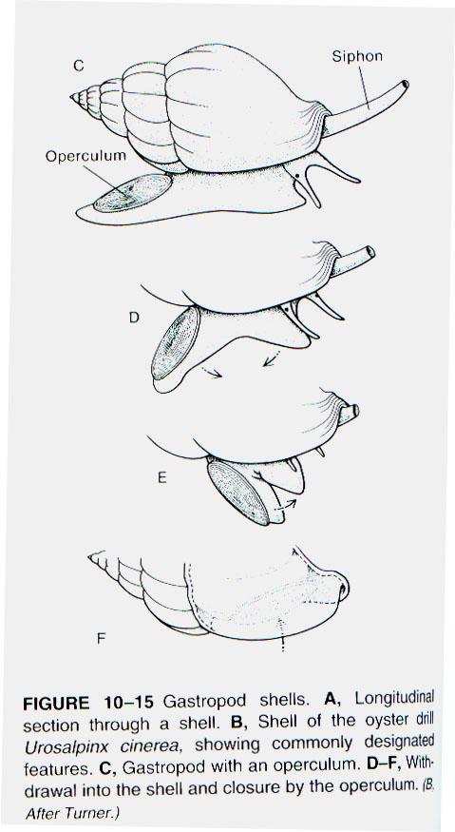
Shell
Most have a single spiraled shell and can move the entire head and foot into this shell for protection.
Also, many gastropods have a hardened plate called the operculum on the back of the foot that plugs the shell aperture when the body is withdrawn.

Slide 20
Nutrition
Many gastropods are herbivores and use their radula to scrape algae from surfaces of rocks.
Some gastropods are active predators and in these the radula is often highly modified, e.g., as a drill (oyster drills) or harpoon (venomous gastropods)

Slide 21
Killer Cone Snails

Slide 22
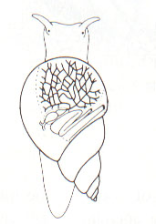
Respiration
Aquatic gastropods possess gills for respiration
Terrestrial gastropods obtain oxygen via a well vascularized mantle
Gills Vascularized
mantle

Slide 23
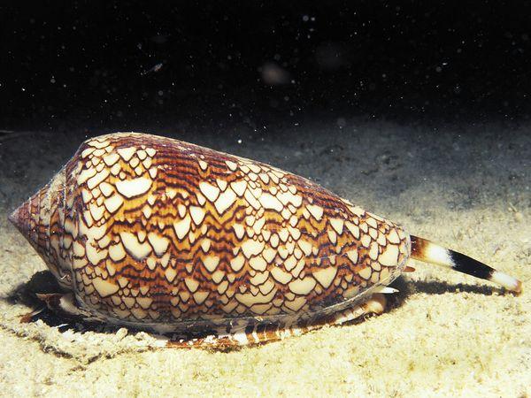
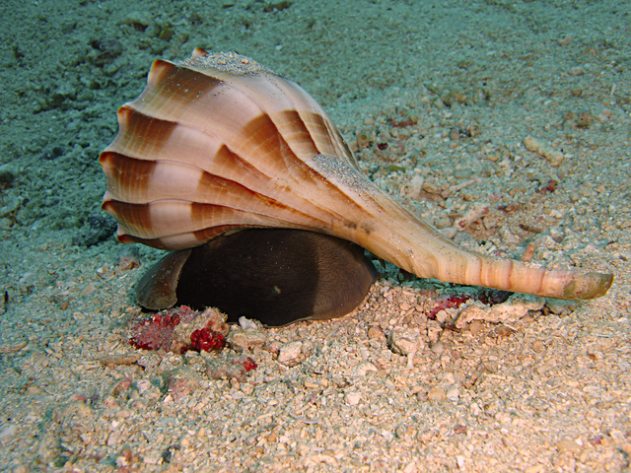
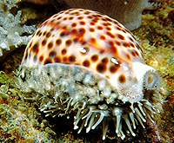
Subclass Prosobranchia
Shelled marine gastropods
Conus geographus
“Geography Cone”
Lobatus gigas
“Queen Conch”
Busycon perversum
“Lightning Whelk”
Cypraea tigris
“Tiger Cowrie”

Slide 24
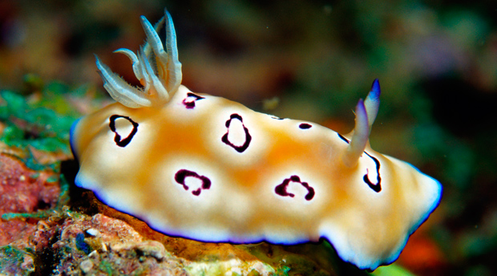
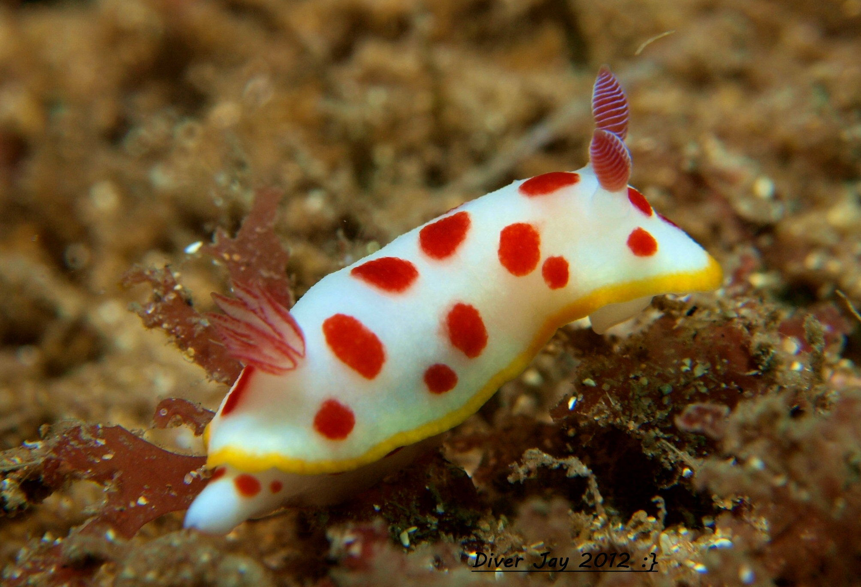
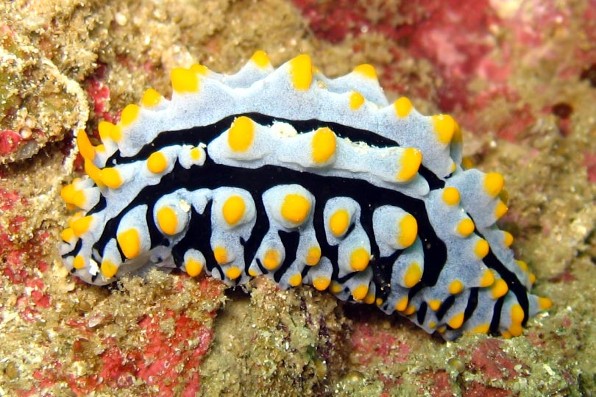
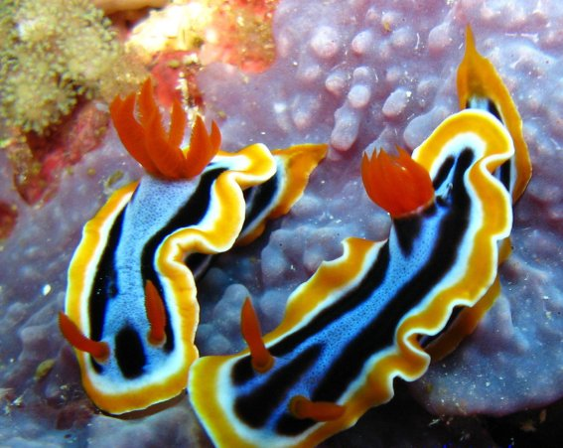
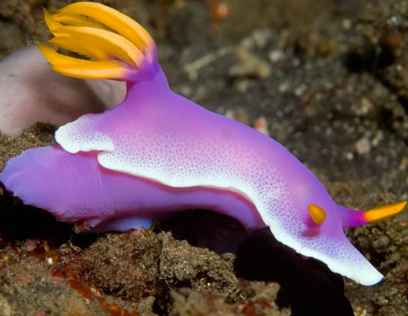
Subclass Opisthobranchia
Sea slugs (marine)

Slide 25
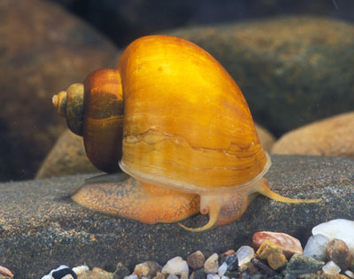
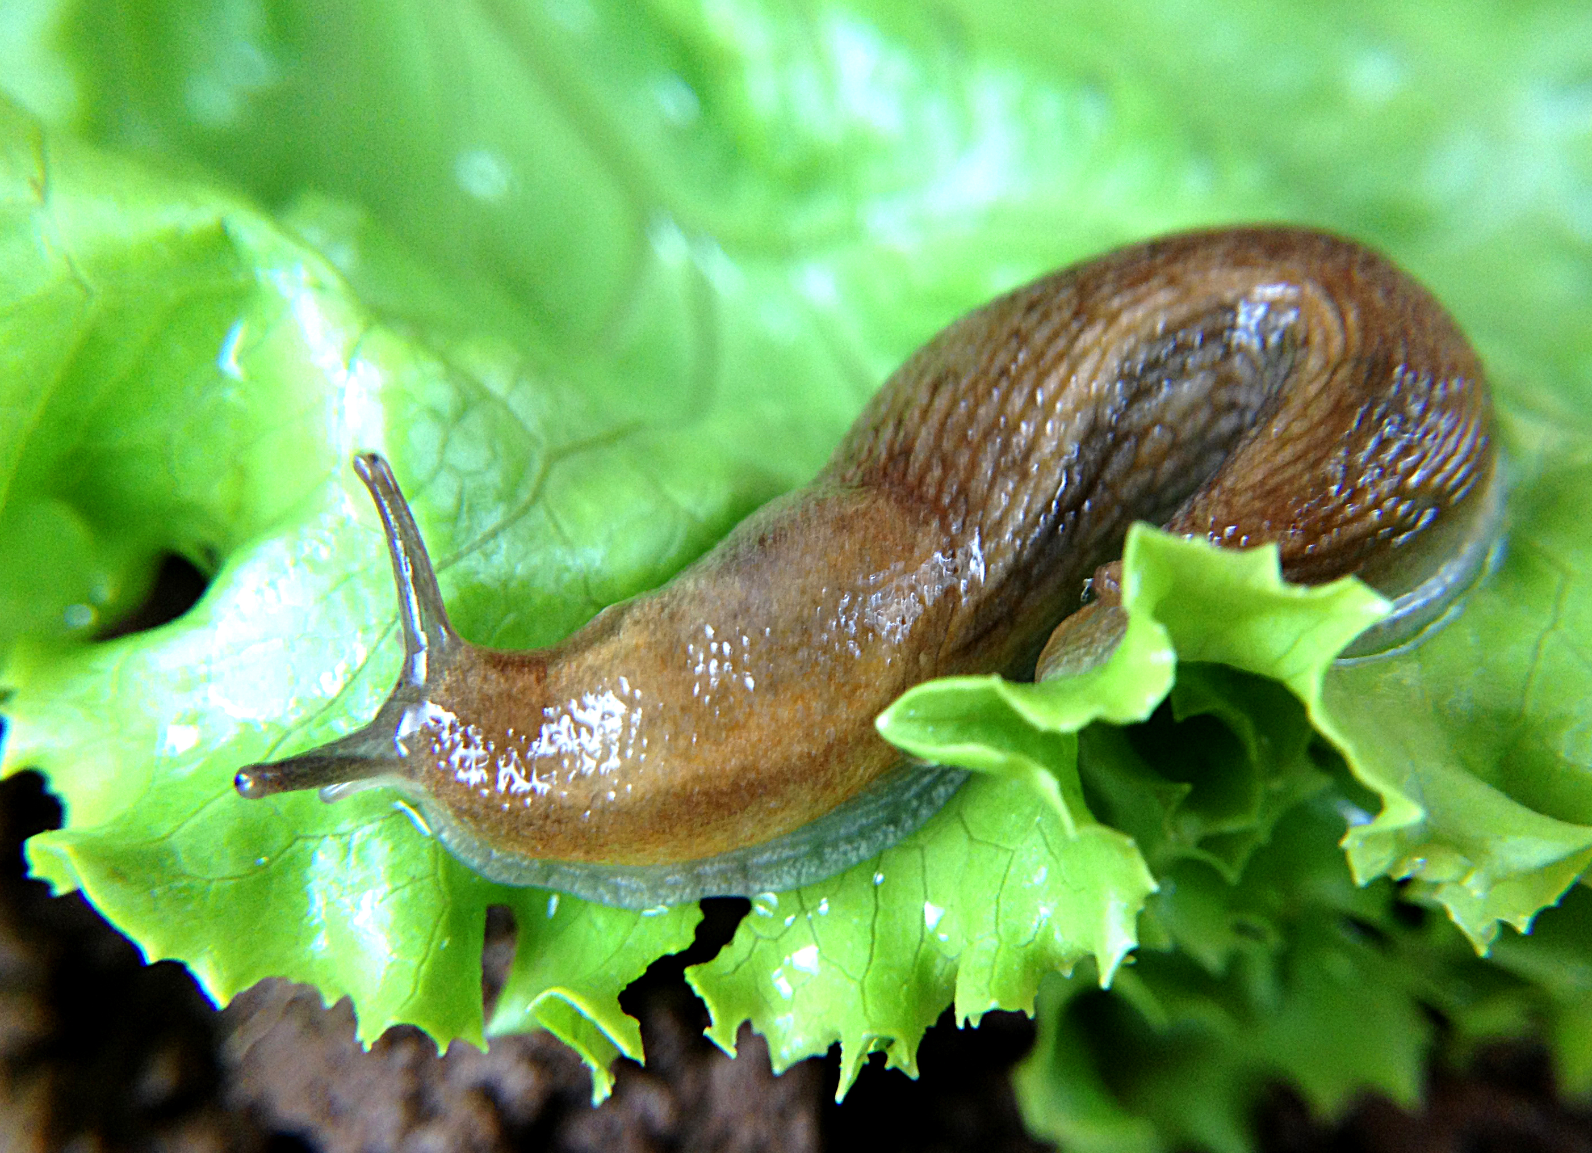
Subclass Pulmonata
Contains most freshwater and terrestrial species

Slide 26
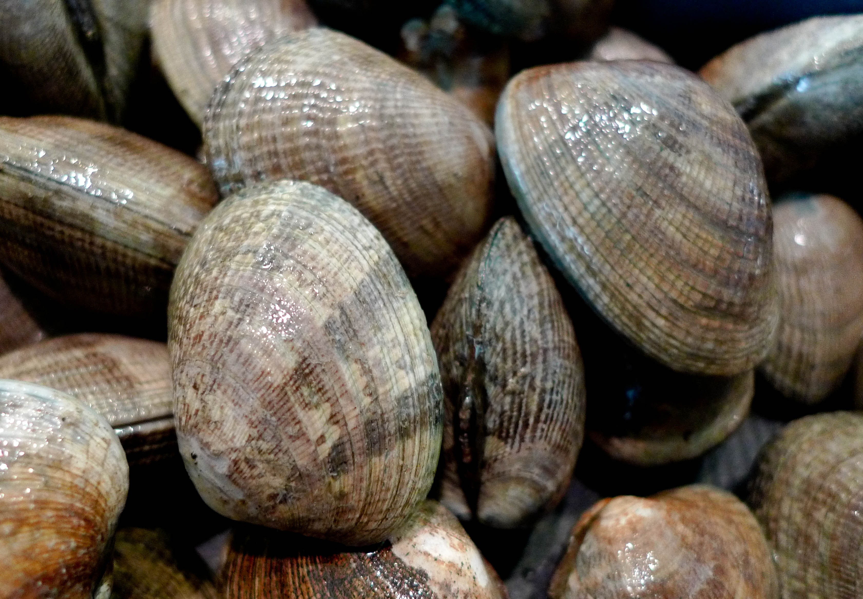
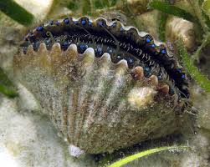
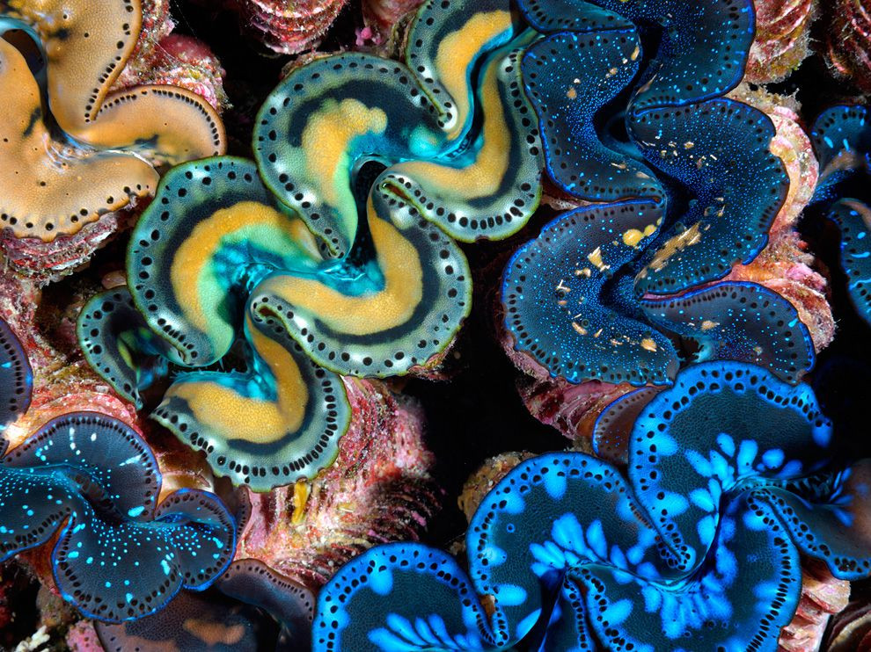
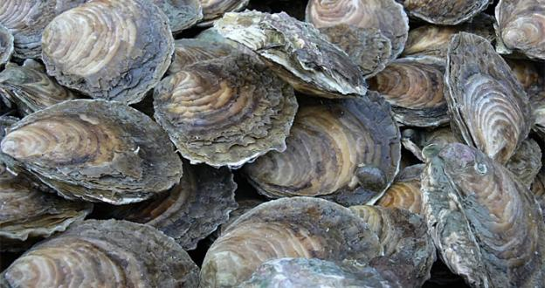
Class Bivalvia
Include mussels, clams, scallops, oysters, and shipworms
Most are sedentary filter feeders that depend on currents produced by cilia on their gills to gather food materials.
They have no head, no radula, and very little cephalization.
Most are marine, but many live in streams, ponds, and lakes.

Slide 27
Shell
Shells divided into 2 equal halves or valves.
The two valves are held together by a hinge lingament.
The valves are drawn together by adductor muscles
The umbo is the oldest part of the shell, and growth occurs in concentric lines around it.

Slide 29
Body and Mantle
The visceral mass is suspended from the dorsal midline, and the muscular foot is attached to the visceral mass.
The posterior edges of the mantle folds are modified to form dorsal excurrent and ventral incurrent openings.
Those that live deep in the sand or mud; burrowing is accomplished using the foot that is extended through a specific part of the shell – the pedal gap.
- these molluscs have long tubular extensions of the mantle
called siphons, with both inhalent and exhalent openings
Those molluscs that live attached to hard surfaces lie in their side and have one of their shells fused or cemented to the substrate; foot is absent

Slide 30
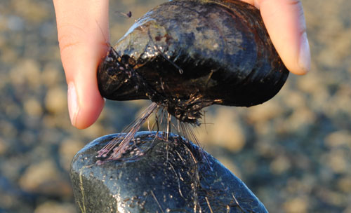
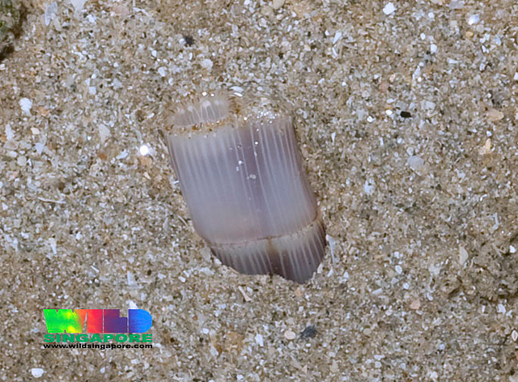
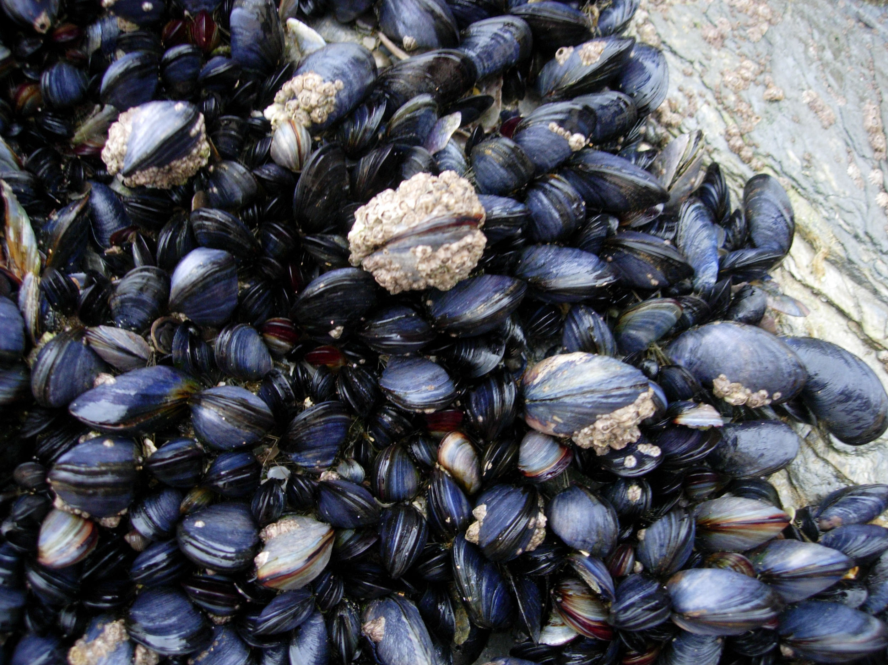

Slide 31
Locomotion
Bivalves move by extending their foot out between the valves and using it to pull themselves (scoot) forward.
Scallops and file shells swim with a jerky motion by clapping their valves together to create a sort of jet propulsion

Slide 32
Reproduction
Most are dioecious (male and female reproductive parts in separate individuals)
Marine forms usually produce free swimming trochophore and veliger larvae
Freshwater bivalve have a different life history pattern; produce larvae called glochidia.
Glochidia are housed in the outer gills (brood chamber) and then parasitize the fins and gills of fish when released

Slide 33
Class Cephalopoda
Include squid, octopus, cuttlefish, and nautilus
All are marine
Evoloved following major readjustments to the HAM body plan:
- Dorso-ventral axis became
elongated and the anterior-
posterior axis became compressed
- Migration of the head to the ventral
part of the body where it fused to the
foot
- The foot is modified as a series of
tentacles or arms
- a circle of 8 or 10 tentacles that are
studded with suckers surround the
head

Slide 34
Feeding
Cephalopods are carnivores
Have a powerful parrot-like beak that is used to tear prey apart.
They also have a powerful radula
In some species of octopus, the salivary glands are modified poison glands

Slide 35
Locomotion
Cephalopods are excellent swimmers: streamlined body; tentacles and fins as stabilizers
Swim by means of jet propulsion, using the highly modified muscular mantle and siphon.
- by relaxing the mantle the mantle cavity is expanded and water
can be drawn in.
- by contracting the mantle water can be forced out through the
siphon

Slide 36
Shell
Primitively the cephalopods possessed a shell; the fossil record indicates both coiled and non-coiled shells.
Extant members with coiled shells include Nautilus
Some cephalopods (cuttlefish) have an internal shell – cuddle bone
The octopods have lost the shell entirely

Slide 37
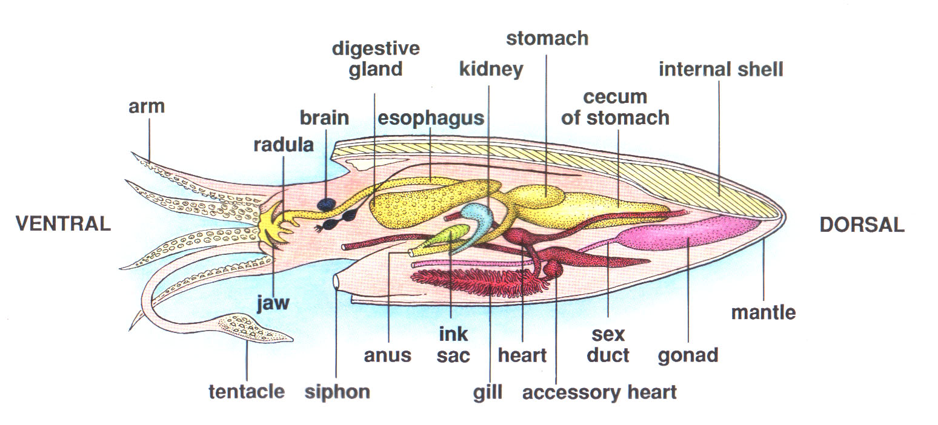
Other General Features
For protection they possess an
ink sac
Cephalopods have well-developed sense organs, including a camera type eye
Some have well-developed brains and show a remarkable capacity for learning
Cephalopods are the only molluscan class with a closed circulatory system

Slide 38
Reproduction
Sexes are separate
Sperm is transferred to females in packets – spermatophores
Male uses a tentacle to reach into its mantle cavity and pick up some spermatophores
It then inserts the tentacle into the mantle cavity of the female near or within the oviduct

Slide 39
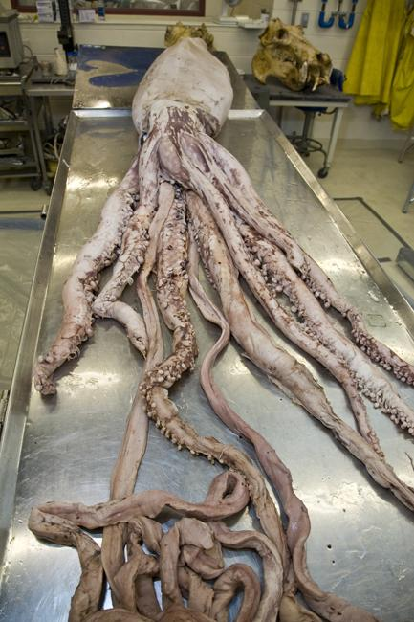
Examples of Cephalopods (Squid)

Slide 40
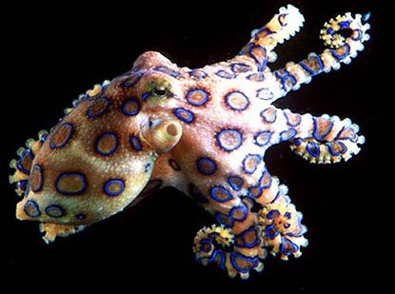
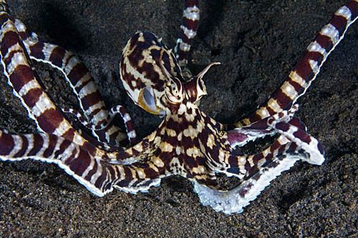
Examples of Cephalopods (Octopus)

Slide 41
Examples of Cephalopods (Cuttlefish)

Slide 42
Examples of Cephalopods (Nautilus)

