Slide 1
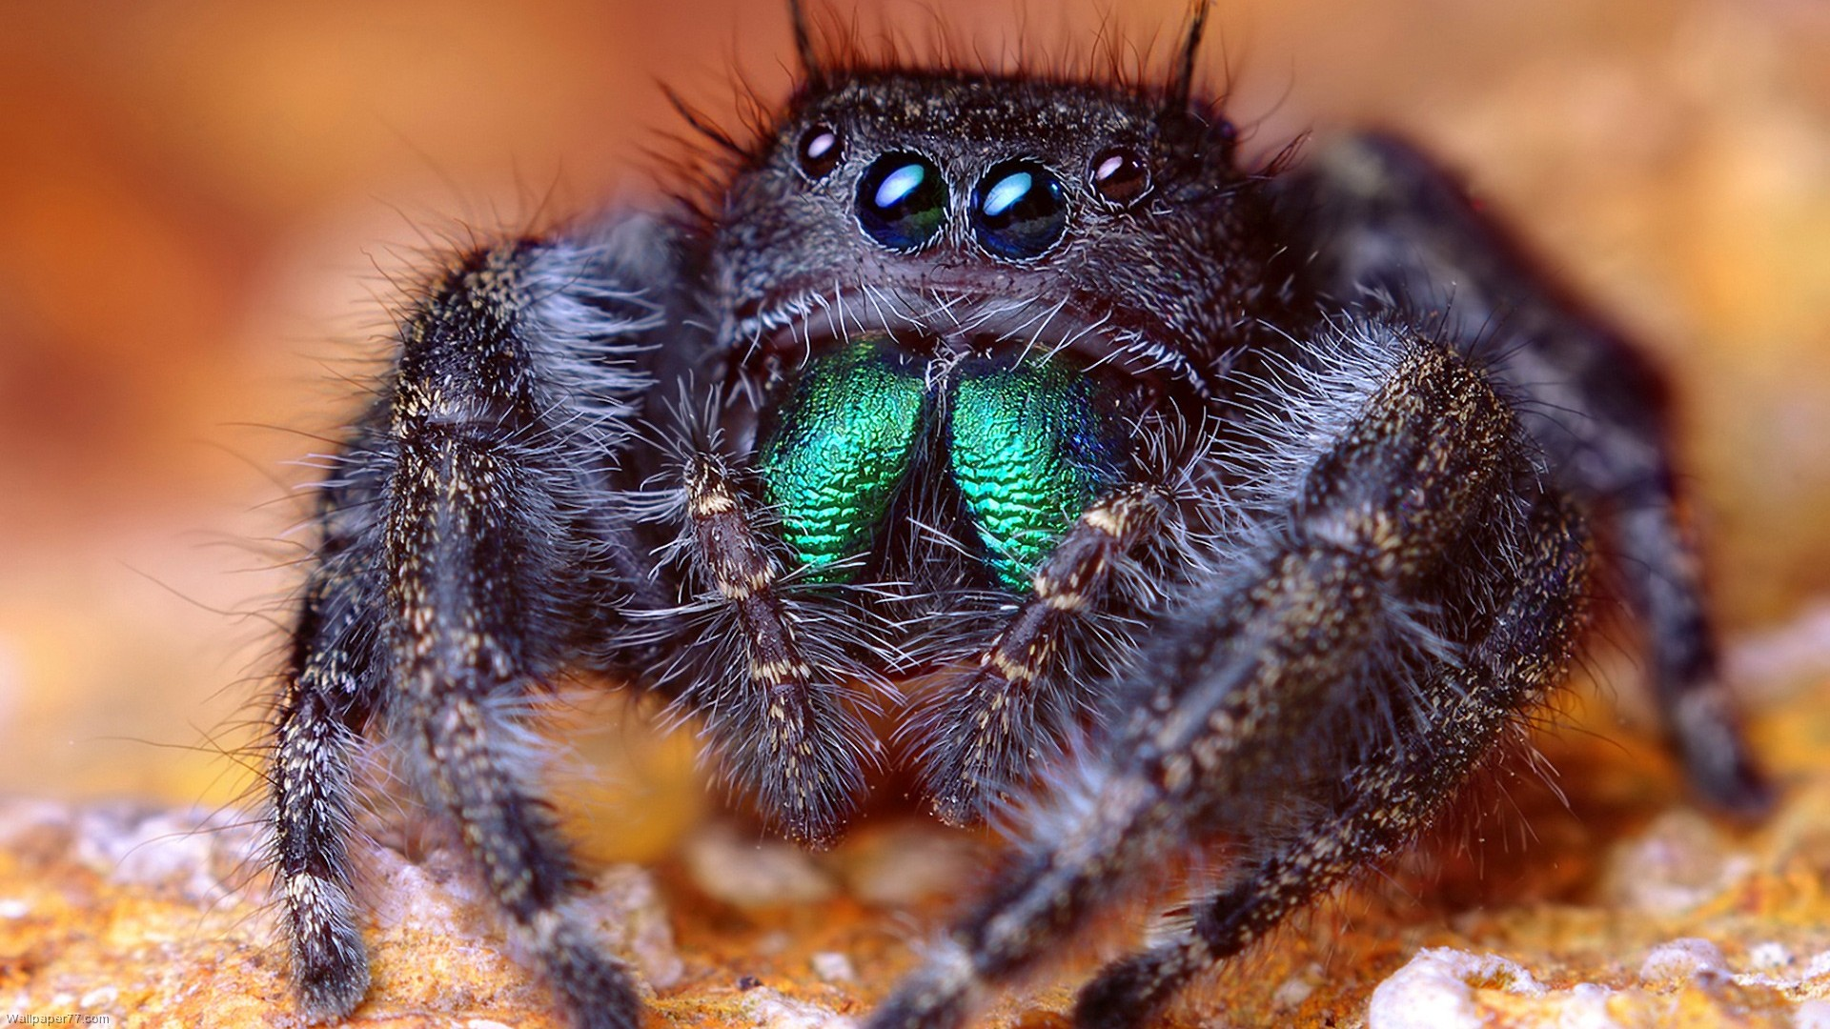
Phylum Arthropoda

Slide 2
Phylum Arthropoda
Greek: arthro = jointed + pod = foot
Huge group!! > 1,000,000 species
- 84% of all animal species are arthropods!!
How can we explain the success of arthropods?
Exoskeleton!!

Slide 3
The Arthropod Exoskeleton
Epidermis secretes an external skeleton called the exoskeleton
Advantages of having an exoskeleton:
- provides strong support
- provides rigid levers that muscles can attach to and pull
against
- offers protection
- serves as a barrier to prevent internal tissues from drying
out; important because many arthropods live on land
- serves as a barrier to prevent infection

Slide 4
Structure of the Exoskeleton
Exoskeleton of chitin and protein (= cuticle)
Structure: - epicuticle (oily, waxy) - exocuticle (chitin & protein) - endocuticle (chitin only) - epidermis secretes cuticle

Slide 5
Problems associated with exoskeleton
MOVEMENT
Solution – Joints in exoskeleton
Exocuticle absent from joints; may form hinges
Endocuticle alone allows flexibility
2. GROWTH
Solution - Molting

Slide 6
Molting
Step 1:
Secretion of “molting fluid” to dissolve old endocutiocle

Slide 7
Molting
Step 2:
New cuticle formed under old exocuticle.
Break out of old cuticle

Slide 8
Molting
Step 3:
Inflate with water/air to increase size while skeleton soft
- but soft skeleton & gravity;
- arthropods are mostly small
Hardening of new exocuticle

Slide 9
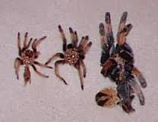
Growth Stages
Arthropods pass through 3 – 20+ growth stages in life cycle
Some stop molting as adults (insect, most spiders)
Some continue to molt (crayfish, tarantulas)

Slide 10
Problems associated with exoskeleton
3. SENSORY INPUT
Touch – sensory setae connected to neurons
Smell & taste – hollow sensory setae w/chemosensitive nerve endings

Slide 11
Problems associated with exoskeleton
3. SENSORY INPUT
Vision – clear cuticle over compound or simple eyes

Slide 12
Problems associated with exoskeleton
3. SENSORY INPUT
Hearing
tympanum = endocuticle, vibrates like eardrum
Trichobothria (right →)

Slide 13
Benefits of Exoskeleton (to the individual)
Support
Locomotion
- lever system (walk, swim, fly)
Mechanical protection (armor)
Retards evaporation (in air) and/or osmosis (in water)
- water balance

Slide 14
Benefits of Exoskeleton (to the phylum)
Reduction of coelom & segmentation
- abandoned hydrostatic system of annelid-like ancestor
- coelom reduced to pericardial cavity
Segments fused = Tagmosis
- specialization of body regions (= tagmata)
- specialization of appendages

Slide 15
Tagmosis
Head (~ 4-6 segments)
- feeding, sensation
Head appendages
- mandibles
- maxillae
- maxillipeds
- chelicerae
- antennae

Slide 16
Tagmosis
Thorax (~ 3-6 segments)
- locomotion, grasping
Thoracic appendages
- walking legs
- wings
- chelipeds

Slide 17
Tagmosis
Abdomen (~ 8-30+ segments)
- respiration, reproduction, etc.
Abdominal appendages
- abdominal gills (aquatic insect larvae)
- swimmerets (crayfish)
- filtering legs (barnacles)
- gonopods (crayfish, etc)
- spinnerets (spiders)

Slide 18
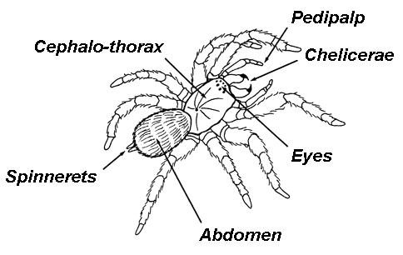
Tagmosis
Number of segments/legs in each tagma varies by subphylum, class.
- Cephalothorax of 6 segments in Chelicerata
- 1 pr. Chelicerae
- 1 pr. Pedipalps
- 4 pr. Walking legs
-

Slide 19
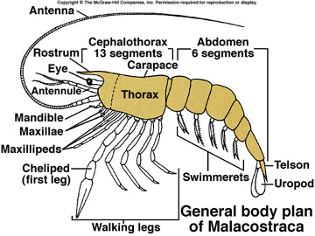
Tagmosis
- Cephalothorax of 13 segments in Crustacea (shrimp, crayfish)
- 2 pr. Antennae
- 1 pr. Mandibles
- 2 pr. Maxillae
- 3 pr. Maxillipeds
- 5 pr. Walking legs

Slide 20
Ways the needs of cells are met
Food – herbivores, predators, detritivores, parasites , filter feeders,…
O₂ and CO₂ exchamge
- gills
- book lungs
- tracheal systems
Waste removal
- diffusion from gills, Malphigian tubules

Slide 21
Other Arthropod Characters
Open Circulatory System:
Dorsal heart pumps hemolymph over brain
Hemolymph moves through hemocoel back toward heart
Ostia (holes) in sides of heart let hemolymph in to go around again

Slide 22
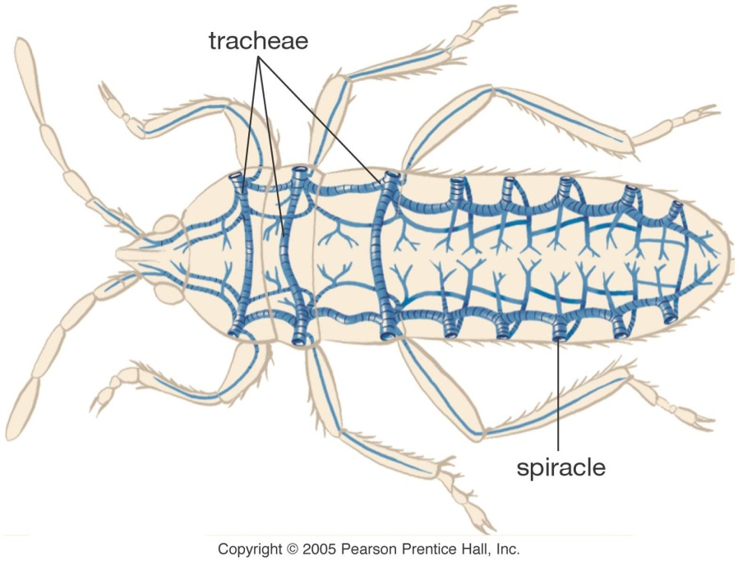
Other Arthropod Characters
Respiratory Systems:
Gills in aquatic/marine arthropods
Book lungs (modified gills) in spiders & scorpions
Tracheal systems in most terrestrial arthropods

Slide 23
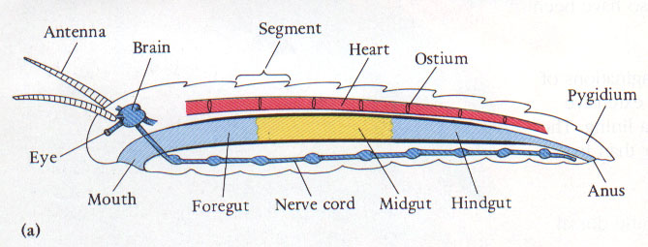
Other Arthropod Characters
Nervous System (resembles that of annelids):
Dorsal brain with nerves around esophagus
Paired ventral nerve cords
Segmental ganglia (often fused into 1-2 ganglia in each tagma)

Slide 24
Reproduction
Sexes are separate
Fertilization is external in aquatic forms
Fertilization is internal for terrestrial forms

Slide 25
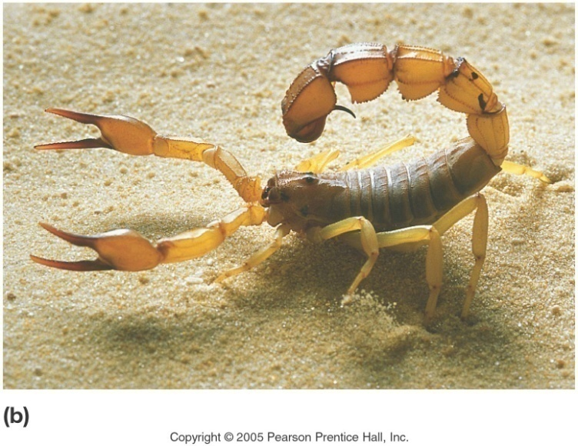
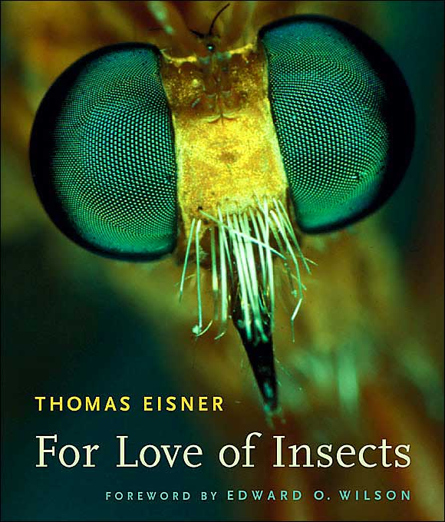
Distinguishing Characters of Arthropoda
Jointed exoskeleton
Tagmosis
Compound Eyes

Slide 26
Arthropod
Diversity

Slide 27
Arthropod Taxonomy: Overview
The arthropods evolved along four main lines, which most zoologists recognize as four distinct subphyla
Trilobita – extinct trilobites
Chelicerata – horseshoe crabs, spiders, ticks, mites and some extinct groups
Crustacea – crabs, shrimp, lobster, barnacles
Uniramia – insects, centipedes, millipedes

Slide 28
Subphylum Trilobita
Class Trilobita
Three lobed head & body (left, middle, right)
Diverse in Paleozoic
~540-240 mya
Extinct

Slide 29
Subphylum Chelicerata
Cephalothorax:
Jaws are chelicerae
Pedipalps
4 pr. Walking legs
Abdomen

Slide 30
Subphylum Chelicerata
Class Meristomata
Horseshoe Crabs
Scorpions ??

Slide 31
Subphylum Chelicerata
Class Arachnida
- lost compound eyes
Spiders
“Daddy-long-legs”
Vinegaroons
Mites & Ticks
Scorpions ??

Slide 32
Subphylum Myriapoda
Myriapoda means “many footed”
Legs unbranched
Head & Body

Slide 33
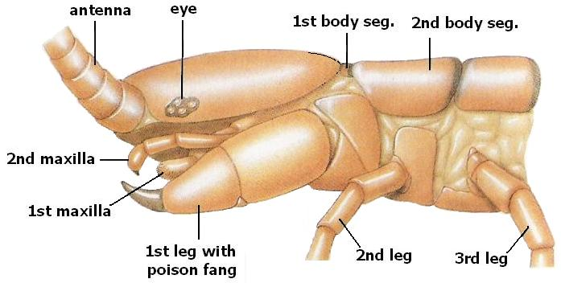
Subphylum Myriapoda
Class Chilopoda – Centipedes
1st legs are fangs
Each segment has 1 pr. legs

Slide 34
Subphylum Myriapoda
Class Diplopoda
Millipedes
Double segments (2 pr. legs per segment

Slide 35
Subphylum Crustacea
2 pr. Antennae (antennules, antennae)
Cephalothorax
13 segments & appendage pairs
Abdomen
Variable among classes

Slide 36
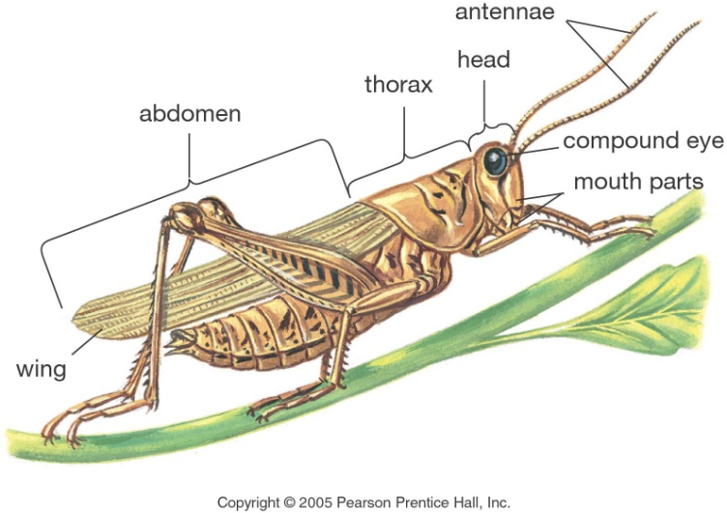
Subphylum Hexapoda
Class Insecta
head, thorax, abdomen
2 pr. Wings
~800,000 species (majority of all arthropods)

Slide 37
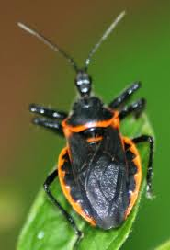
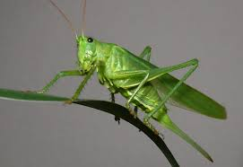
Class Hexapoda
Class Insecta
Incomplete metamorphism
Odonata (dragonflies)
Orthoptera (Grasshopper)
Hemiptera (assassin bugs)
Blattodea (cockroaches)

Slide 38
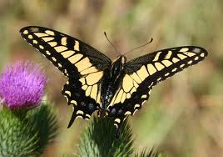
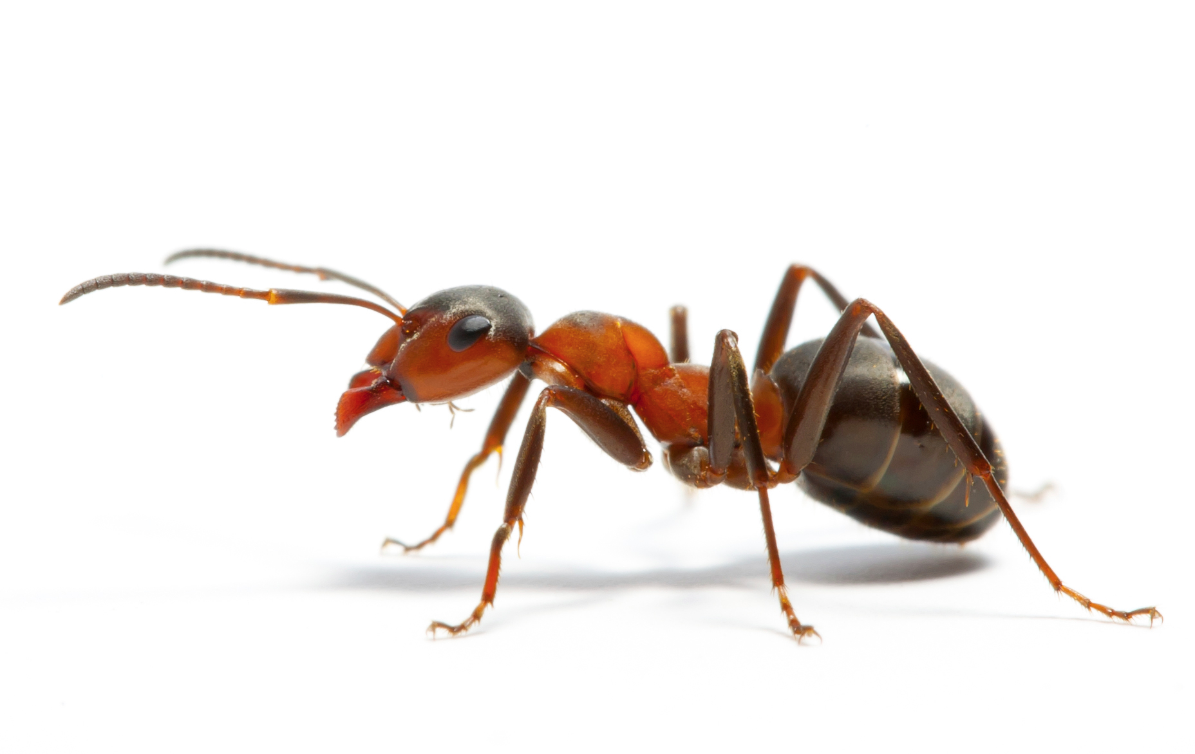
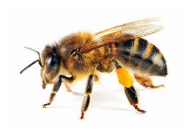
Class Hexapoda
Complete metamorphism
Coleoptera (beetles)
Hymenoptera (ants, bees)
Diptera (flies)
Lepidoptera (butterflies)

