Slide 1
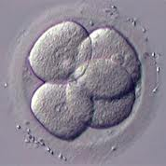
Principles of Development
Chapter 8

Slide 2
Fertilization
The union of male and female gametes to form a zygote.
Fertilization accomplishes two things:
1. it provides for recombination of paternal and
maternal genes (restoring the original diploid
number of chromosomes).
2. activates the egg to begin development
Some species can be artificially induced to initiate fertilization (artificial parthenogenesis) and some don’t need sperm at all (parthenogenesis).

Slide 3
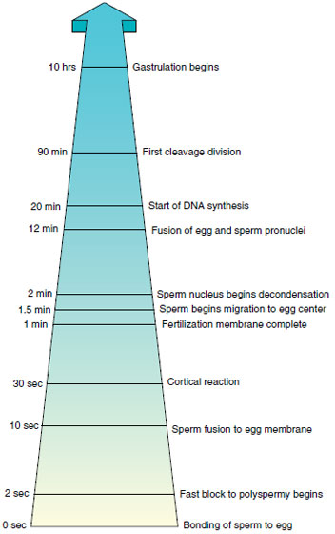

Slide 4
Cleavage and Early Development
During cleavage the embryo divides repeatedly to convert the large cytoplasmic mass into a large cluster of small, maneuverable cells called blastomeres.
No growth occurs during this period, only subdivision of mass, which continues until normal somatic cell size is attained.
At the end of cleavage, the zygote has been divided into many hundreds or thousands of cells and the blastula stage is formed

Slide 5
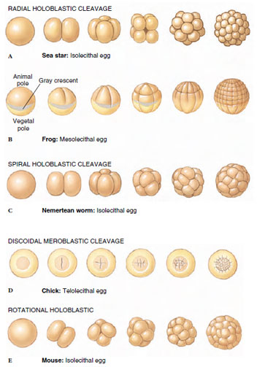
The yolk-rich end is the vegetal pole and the other end is the animal pole.
During each division, a distinct cleavage furrow is visible in the cell.
Isolecithal – very little yolk, evenly distributed
Mesolecithal – moderate yolk, concentrated at vegetal pole
Telolecithal – lots of yolk, concentrated at vegetal pole
Explain the difference between holoblastic and meroblastic eggs

Slide 6
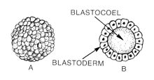
Development After Cleavage
Blastulation:
- cleavage leads to a cluster of cells called a blastula
- In most animals, the cells are arranged around a
central fluid-filled cavity called a blastocoel.

Slide 7
Gastrulation:
- during gastrulation, the spherical blastula is
converted into a more complex configuration
forming a second germ layer.
- The sphere is pushed inward forming a pouch
called an archenteron or a gastrocoel. The
opening to the pouch/gut is called a blastopore.
- The gastrula stage has two layers of cells
surrounding the blastocoel:
ectoderm – outer skin
endoderm – inner skin

Slide 8
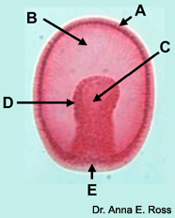
A – ectoderm
B – blastocoel
C – archenteron/gastrocoel
D – endoderm
E – blastopore

Slide 9
Formation of a Complete Gut
If the gut only opens at the blastopore it is called an incomplete gut (sea anemones and flatworms)
- food must be completely digested or undigested
parts egested back through the mouth.
Most animals have a complete gut with a second opening, the anus
When a complete gut forms, the archenteron moves inward until it meets the ectodermal wall of the gastrula. The endodermal tube now has two openings.

Slide 10
Formation of Mesoderm
Animals with two germ layers are called diploblastic (ex. Sea anemones and comb jellies). Most animals have a third germ layer and are triploblastic.
The third layer is called the mesoderm and lies between the endoderm and ectoderm.
At the end of gastrulation, ectoderm covers the embryo, and mesoderm and endoderm have been brought inside. As a result, cells have new positions and new neighbors, so interactions among cells and germ layers then generate more of the body plan.

Slide 11
Formation of the Coelom
Cells forming mesoderm are derived from the endoderm, but there are two ways that a middle tissue layer of mesoderm can form, schizocoely and enterocoely.
schizocoelous – mesodermal cells fill the blastocoel,
forming a solid band of tissue around
the gut.
*then through programmed cell death,
space (coelom) opens inside the
mesodermal band.
*the embryo now has two body, the gut
and the coelom.

Slide 12
Formation of the Coelom
enterocoelous (deuterostomes) – mesoderm forms
when cells from the central portion of
the gut lining begin to grow outward
as pouches, expanding into the
blastocoel.
*as the pouches move outward, they
enclose a space which becomes a
coelomic cavity or coelom
* the coelom completely fills the
blatocoel.
*the embryo has two body cavities, a
gut and a coelom

Slide 13
Formation of the Coelom
A coelom is a body cavity completely surrounded by mesoderm.
The mesoderm with its internal coelom lies inside the space previously occupied by the blastocoel.
When coelom formation is complete, the body has three germ layers and two cavities.

Slide 14
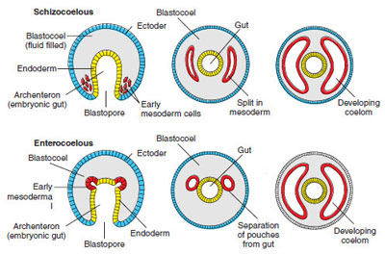

Slide 15
There are two major groups of triploblastic animals:
- protostomes
- deuterostomes
The groups are identified by a suite of four developmental characters:
1. radial or spiral positioning of cells as they cleave
2. regulative or mosaic cleavage of cytoplasm
3. fate of the blastopore to become mouth or anus
4. schizozoelous or enterocoelous formation of
coelom

Slide 16
Deuterstome Development
Cleavage Patterns:
radial cleavage – embryonic cells are arranged in
radial symmetry around animal-
vegetal axis
regulative development – fate of a cell depends on
its interactions with
neighboring cells; cell
fates are not fixed early
in development.
- each cell is able to produce entire
embryo if separated from other cells

Slide 17
Fate of Blastopore:
blastopore become anus and second opening
becomes the mouth
Coelom Formation:
coelom formation – coelom forms by enterocoely.
Both the mesoderm and coelom
are formed at the same time.
Slight variations may occur depending on the animal being studied.
Examples: mammals, reptiles, birds, and fish

Slide 18
Protostome Development
Cleavage Patterns
spiral cleavage – cleavage planes are diagonal to the
polar axis
mosaic development – cell fate is determined by the
distribution of certain proteins
and messenger RNA’s, called
morphogenetic determinants.
Fate of Blastopore
blastopore becomes the mouth and the second
opening becomes the anus

Slide 19
Coelom Formation
- coelom forms by splitting (schizocoely)
- mesoderm forms when endodermal cells arise
ventrally at the lip of the blastopore
Examples: segmented worms, molluscs, arthropods,
roundworms

Slide 20
