Slide 1
Phylum Annelida

Slide 2
Annelid Characteristics
Annelids are to be found in marine, freshwater, and terrestrial habitats
The body is vermiform, bilaterally symmetrical, and segmented (metamerism)
Each segment is separated from contiguous ones by a transverse septum
The body is triploblastic with a well developed coelom
The body is covered with a flexible non-chitinous cuticle (secreted by epidermis)
Most forms have setae – hard, bristle-like chitinous structures
Digestive system is complete
Circulatory system is closed
Excretory system typically consists of a pair of nephridia per segment

Slide 3
Typical Arrangement of Segments

Slide 4
Phylum Annelida
Class
Polychaeta
Class
Clitellata
Class
Aelosomata
Marine worms
Aelosomata
Subclass
Oligochaeta
Subclass
Hirudinae
earthworms
Leeches

Slide 5
Class polychaeta
Feather Duster Worms, Clam worms,
Christmas Tree worms

Slide 6
Class Polychaeta
Largest group of annelids
Primarily marine
Many setae on fleshy lateral outgrowths of the body wall known as parapodia
- parapodia differ from species to species and play an
important role in identification
Well developed head with eyes and other sensory structures
Sexes separate, with a free-swimming trochophore larva

Slide 7
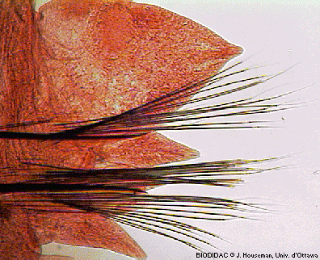
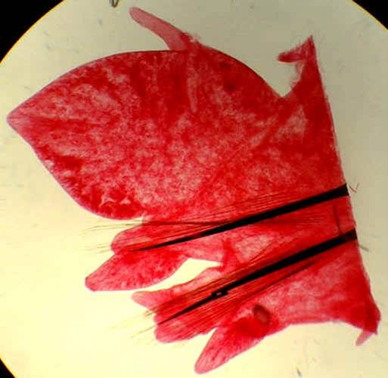
Class polychaeta
Parapodia:

Slide 9
Class polychaeta examples

Slide 10
Class polychaeta examples

Slide 11
Class polychaeta examples

Slide 12
Class polychaeta examples

Slide 13
Class clitellata
Earthworms and Leeches

Slide 14
Subclass oligochaeta
Terrestrial with a few freshwater species
Lack parapodia and have few setae
Lack the distinctive head region of polychaetes and have no eyes
Clitellum present
Hermaphrodites, with copulation required
Eggs are deposited in a cocoon and development is indirect

Slide 15
Subclass oligochaeta
Feeding and digestion:
- scavengers that consume soil that contains
organic matter
- the ingested soil moves into a storage chamber
called the crop, then to an area called the
gizzard, where grinding action breaks down the
soil particles. Undigested material passes out
anus in a form called castings, which are prized
as soil fertilizer.

Slide 16
Subclass oligochaeta

Slide 17
Subclass oligochaeta

Slide 18
Subclass oligochaeta

Slide 19
Subclass hirudinea
Known as Leeches
Most live in fresh bodies of water, but some live among moist vegetation
Suckers found on both ends
Unlike other annelids, it segments are not separated internally
Leeches lack both setae and parapodia
They secrete anticoagulants, hirudin, to keep blood from clotting and anesthetic that prevents the host from feeling their presence

Slide 20
Subclass hirudinea

Slide 21
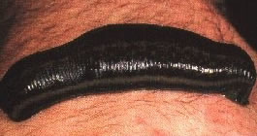
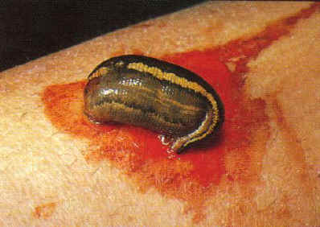
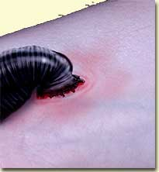
Subclass hirudinea

